Slide 1
Lab 2 Shell Script
Professor: Dr. Hsung-Pin Chang
TA: Gang Yang
Operating System Lab

Slide 2
Outline
Introduction
Vim Basics
Bash Shell Scripting Tutorial
Exercise

Slide 3
Introduction
A shell script is a script written for the shell, or command line interpreter, of an operating system
It is often considered a simple domain-specific programming language (DSL)
Notes:
Shell是系統溝通的一個工具介面

Slide 4
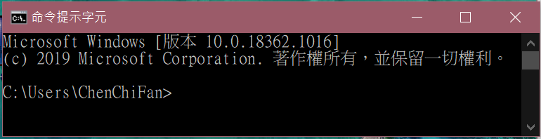
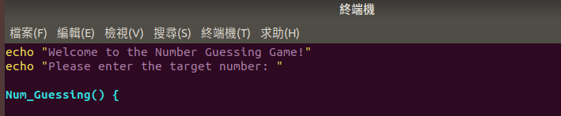
cmd
Windows:
指令程式
shell
Linux:
shell script

Slide 5
Introduction
Typical operations performed by shell scripts include
file manipulation
program execution
printing text

Slide 6
Vim Basics
Vim is a popular and cross-platform editor
Shell open : ctrl + alt + t
Type vim /path/to/file in shell to open a file
Start typing something by pressing i
Exit vim by pressing Esc then writting :q + Enter
Save your file similarly but using :w

Slide 7
Vim Basics
Hello Vim!
Install Vim through apt-get command in shell
Create a file named “helloworld”
Type “Hello World!” using insert mode
Return to normal mode by pressing Ese
Save and quit the file

Slide 8
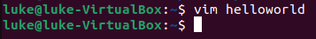
Step 1. Create a file named helloworld
Type “vim helloworld” to create a file named helloworld

Slide 9
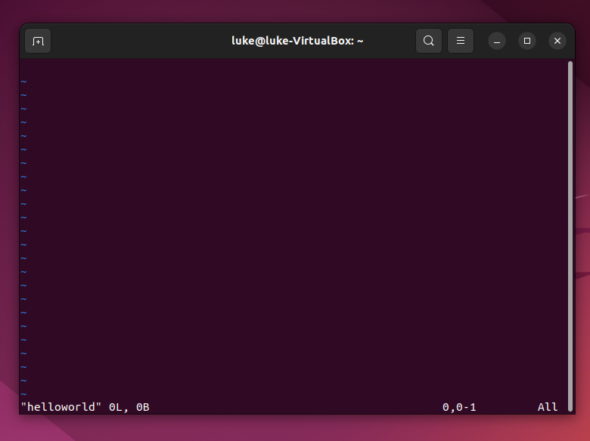
Step 2. Enter Insert Mode
You need to enter insert mode by pressing “i” before typing something

Slide 10
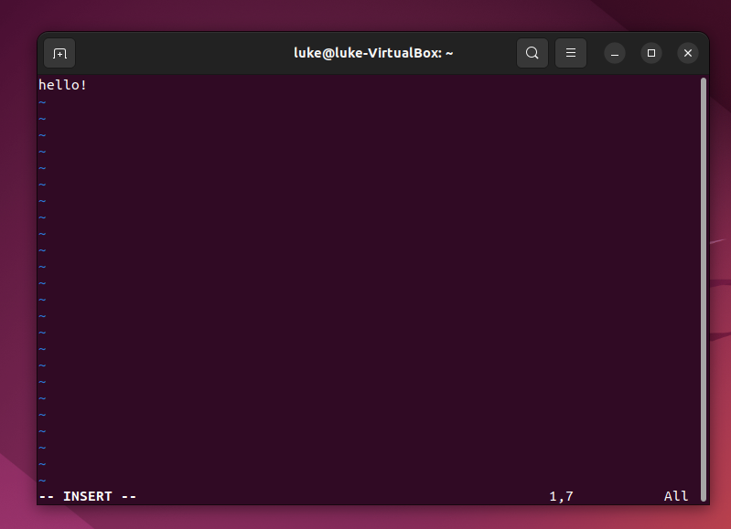
Step 3. Type something
Notice the “-- INSERT --” on bottom left and you can type something now

Slide 11
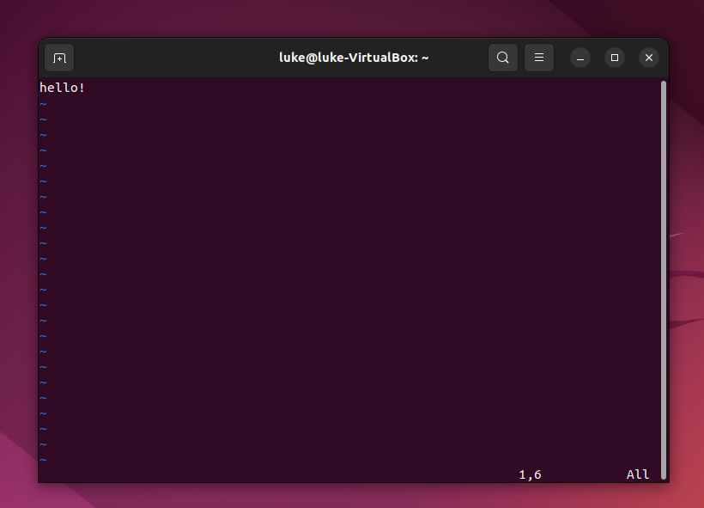
Step 4. Return to Normal Mode
Press “Ese” to return to normal mode

Slide 12
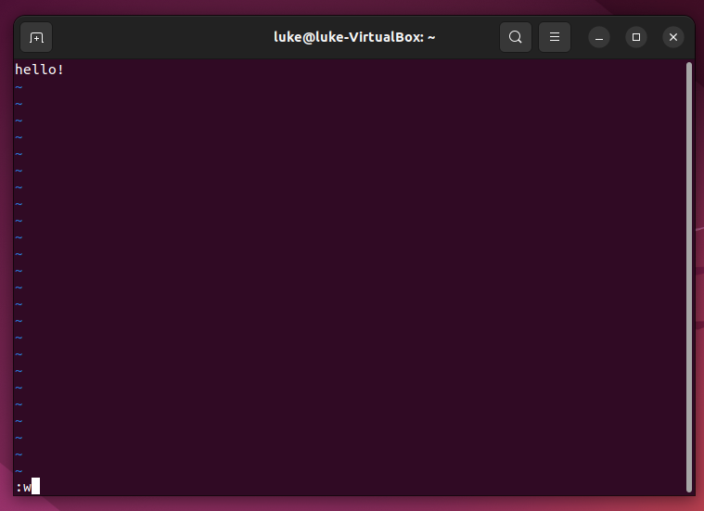
Step 5. Save the File
Type “:w” in normal mode to save your file

Slide 13
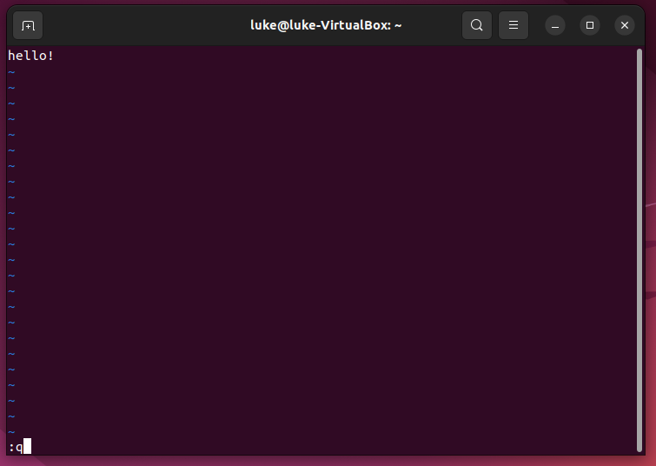
Step 6. Quit Vim
Type “:q” in normal mode to quit Vim

Slide 14
Note : 1) Shell open : ctrl + alt + t 2) vim open : vim helloworld.sh 3) before typing : i 4) Exit : Esc 5) Save the File : :w 6) Quit Vim : :q + Enter

Slide 15
Bash Shell Scripting Tutorial
Bash is a free software Unix shell written for the GNU Project
It is the default shell on most systems built on top of the Linux kernel as well as on Mac OS X and Darwin
You still can do the same thing by other programming languages like Perl, Python, etc

Slide 16
Bash Shell Scripting Tutorial
Hello World!
The simplest Hello World example

Slide 17
Hello World in Shell
Just simply type “echo Hello World!” in your shell and it’s done!

Slide 18
Bash Shell Scripting Tutorial
Hello World using .sh File
Now let’s use .sh file to do the same thing

Slide 19
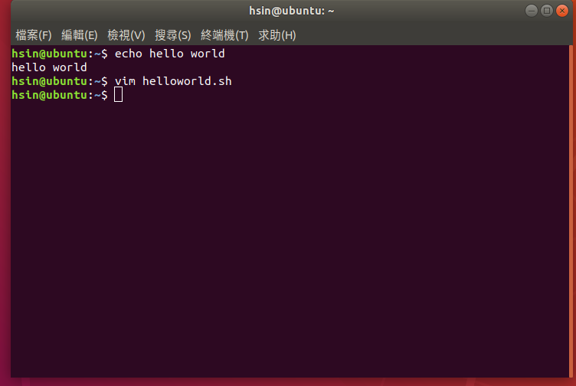
Step 1. Create a file with .sh extension
Type “vim helloworld.sh” in shell to create a new shell file

Slide 20
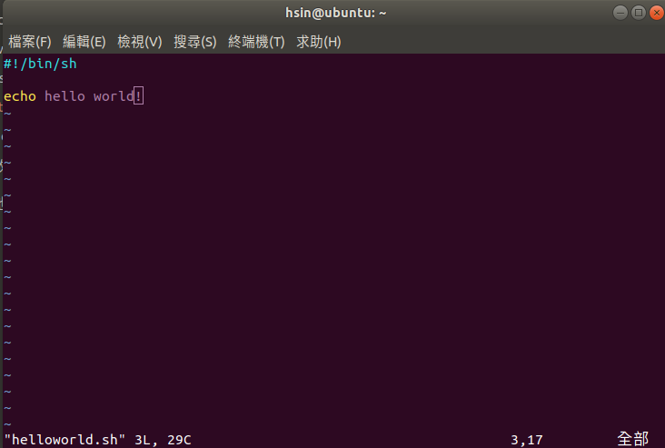
Step 2. Write the script
Enter the insert mode to write our hello world script

Slide 21
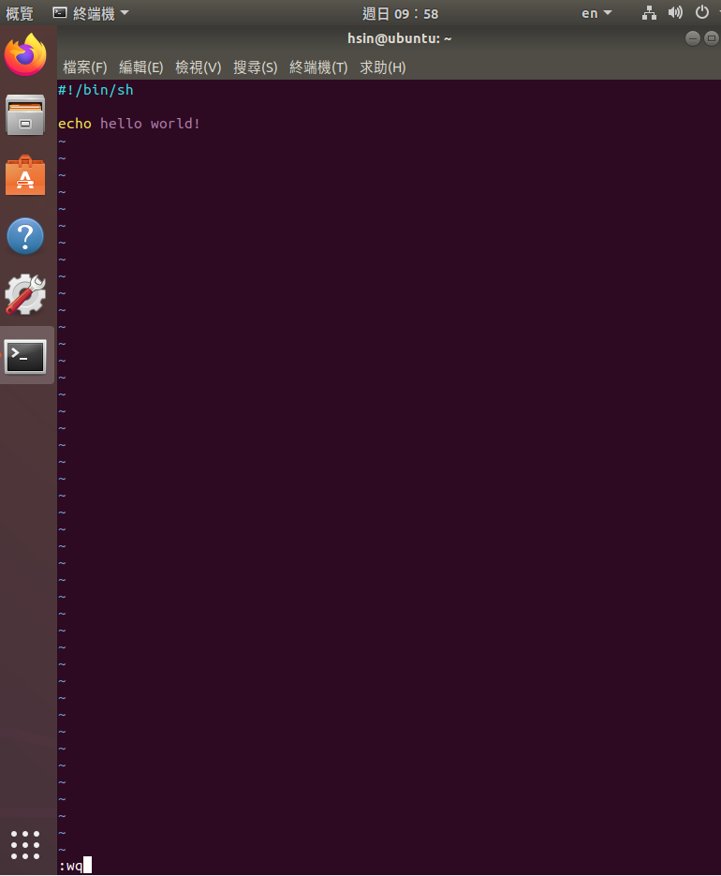
Step 3. Save and Quit the File
Return to the normal mode and type “:wq” to save and quit the file

Slide 22
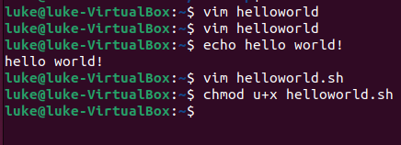
Step 4. Grant execute permission
Use chmod command to grant execute permission to the shell file

Slide 23
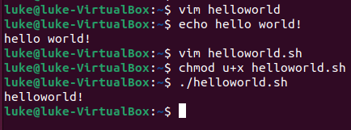
Step 5. Execute the script
Now we can execute the script directly by “./helloword.sh” command

Slide 24
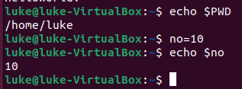
Bash Shell Scripting Tutorial
Variable in Shell
There are two types of variable
System variables
Ex: use “echo $PWD” to print your current working directory
User defined variables (UDV)
Ex: use “no=10” to set variable no and use “echo $no” to print 10 on your screen

Slide 25
Bash Shell Scripting Tutorial
Shell Arithmetic
+ - * /
Syntax: expr op1 math-operator op2
$ expr 1 + 3 # print 4
$ expr 2 - 1 # print 1
$ expr 10 \* 3 # print 30
$ echo `expr 6 + 3` # print 9
space
Upper left corner
on keyboard

Slide 26
Bash Shell Scripting Tutorial
More about Quotes
Double quotes (“): Anything enclosed in double quotes removed meaning of that characters (except \ and $)
Single quotes (‘): Enclosed in single quotes remains unchanged
Back quotes (`): To execute command

Slide 27
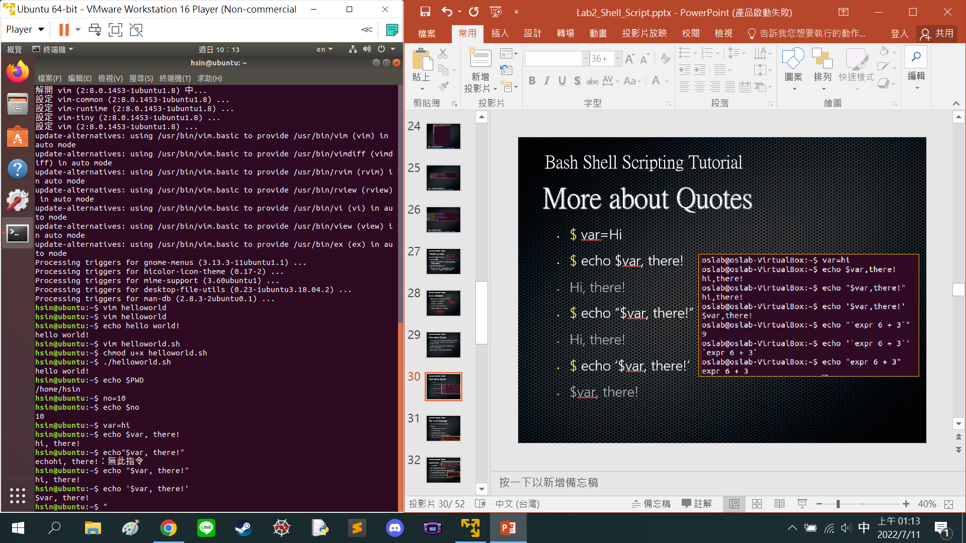
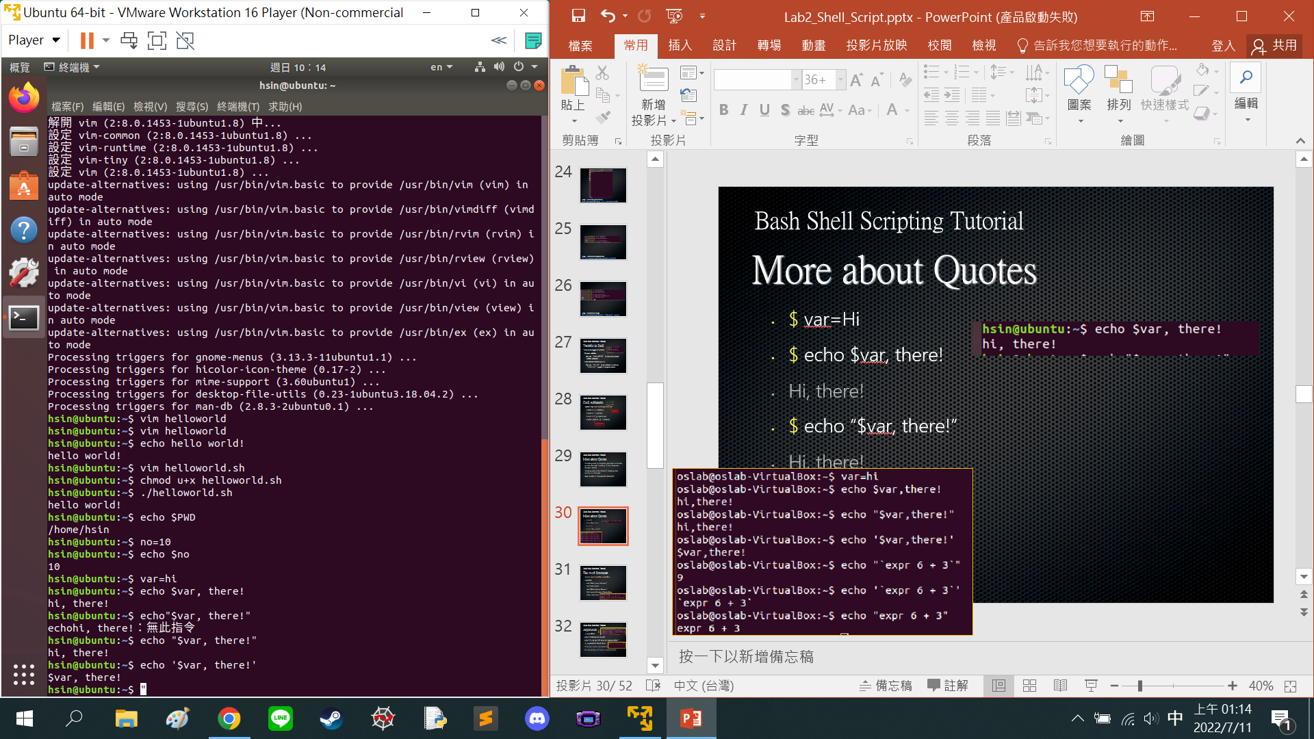
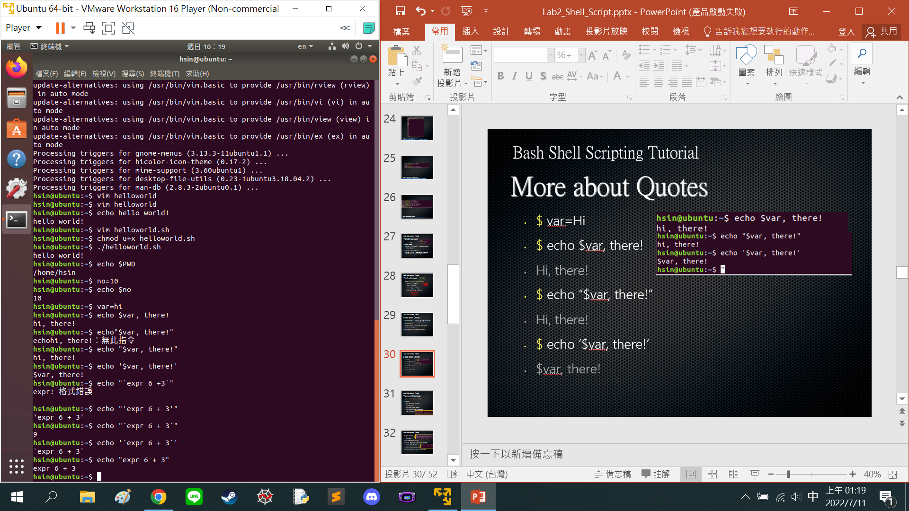
Bash Shell Scripting Tutorial
More about Quotes
$ var=Hi
$ echo $var, there!
Hi, there!
$ echo “$var, there!”
Hi, there!
$ echo ‘$var, there!’
$var, there!

Slide 28
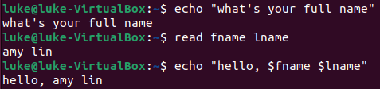
Bash Shell Scripting Tutorial
The read Statement
Syntax: read variable1 variable2 …
Example:
echo “What’s your full name:”
read fname lname
echo “Hello, $fname $lname.”
What’s your full name: Chuck Bass
Hello, Chuck Bass.

Slide 29
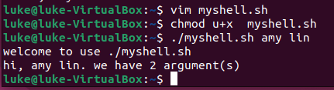
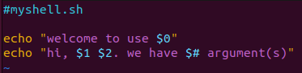
Bash Shell Scripting Tutorial
Arguments
Step 1
Step 3
Step 4
# myshell.sh
echo “Welcome to use $0”
echo “Hi, $1 $2. We have $# argument(s).”
$ ./myshell.sh amy lin
Welcome to use ./myshell.sh
Hi, amy lin. We have 2 argument(s).
Step 2

Slide 30
Bash Shell Scripting Tutorial
Pipes
A pipe is a way to connect the output of one program to the input of another without any temporary file
Ex: think about the ls and sort commands
We can use ls to list directory contents
We can also use “ls | sort -r” to list sorted directory contents reversely

Slide 31
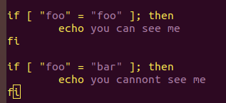
Bash Shell Scripting Tutorial
Conditionals
if-then
if [ “foo” = “foo” ]; then
echo You can see me
fi
if [ “foo” = “bar” ]; then
echo You cannot see me
fi
Linux shell中,
比較時,等號左右必須有空格
space
賦值時,等號旁邊不能有空格

Slide 32
Bash Shell Scripting Tutorial
Conditionals
test command or [ expr ]
used to see if an expression is true
returns 0 for true and nonzero for false
Use test command:
if test “foo” = “bar”; then
echo You cannot see me
fi
Use [ expr ]:
if [ “foo” = “bar” ]; then
echo You cannot see me
fi

Slide 33
Bash Shell Scripting Tutorial
Conditionals
test command or [ expr ]
-eq | is equal to
-ne | is not equal to
-lt | is less than
-le | is less than or equal to
-gt | is greater than
-ge | is greater than or equal to
Operators for Mathematics

Slide 34
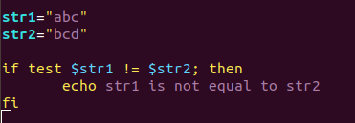
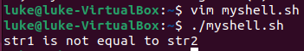
Bash Shell Scripting Tutorial
Conditionals
test command or [ expr ]
str1 = str2 | str1 is equal to str2
str1 != str2 | str1 is NOT equal to str2
str1 | str1 is NOT NULL or not defined
-n str1 | str1 is NOT NULL or does exist
-z str1 | str1 is NULL and does exist
Operators for Strings

Slide 35
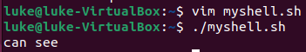
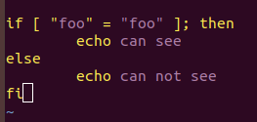
Bash Shell Scripting Tutorial
Conditionals
if-then-else
if [ “foo” = “foo” ]; then
echo can see
else
echo can not see
fi

Slide 36
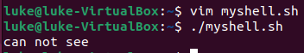
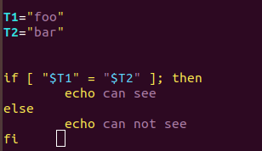
Bash Shell Scripting Tutorial
Conditionals
Conditionals with variables
T1=”foo”
T2=”bar”
if [ “$T1” = “$T2” ]; then
echo can see
else
echo can not see
fi

Slide 37
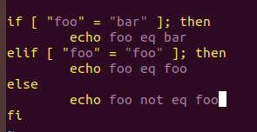
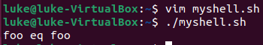
Bash Shell Scripting Tutorial
Conditionals
if-then-elif-then-else
if [ “foo” = “bar” ]; then
echo foo eq bar
elif [ “foo” = “foo” ]; then
echo foo eq foo
else
echo foo not eq foo
fi

Slide 38
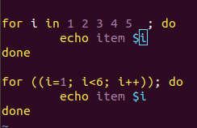
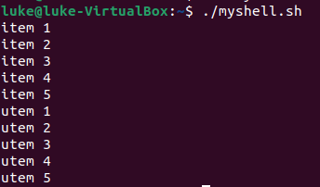
Bash Shell Scripting Tutorial
Loops
for loop
for i in 1 2 3 4 5; do
echo Item $i
done
for ((i=1; i<6; i++)); do
echo Item $i
done
Result:
Item 1
Item 2
Item 3
Item 4
Item5…

Slide 39

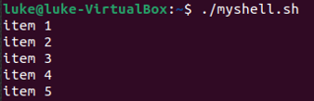
Bash Shell Scripting Tutorial
Loops
while loop
i=1
while [ $i -lt 6 ]; do
echo Item $i
i=`expr $i + 1`
done
Result:
Item 1
Item 2
Item 3
Item 4
Item5

Slide 40
Bash Shell Scripting Tutorial
The case Statement
Syntax
case $var in
pattern1) command;;
pattern2) command;;
patternN) command;;
*) command;;
esac

Slide 41
Bash Shell Scripting Tutorial
The case Statement
Example: name.sh
case $1 in
“Amy") echo “Amy Lin";;
“Jimmy") echo “Jimmy Wang";;
“Johnny") echo “Johnny Chen";;
“Purple") echo “Purple Red";;
*) echo "Enter a first name "
esac

Slide 42
Bash Shell Scripting Tutorial
The case Statement
Result
$ ./name.sh
Enter a first name in
$ ./name.sh Amy
Amy Lin
$ ./name.sh Johnny
Johnny Chen
$ ./name.sh Purple
Purple Red

Slide 43
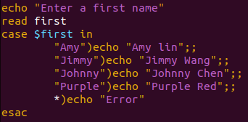
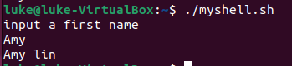

Slide 44
Bash Shell Scripting Tutorial
Function
Example
num=10
PrintNumber() {
echo “The number is $num!”
}
PrintNumber;
Result:
The number is 10!

Slide 45
Exercises
Number Guessing Game
Define the number range between 1 and 10
Ask the user to enter a target number at beginning
Keep narrowing down the number range until the player guessing the right target number

Slide 46
Exercises
Use echo, read, loop and conditionals
Use function to ask for guessing number
Use argument to set the target number

Slide 47
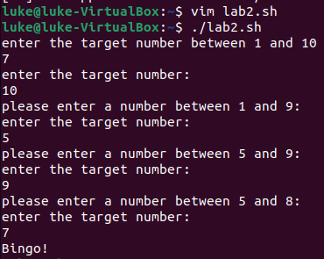
Result

Slide 48
References
Shell script
Advanced Packaging Tool (APT)
New to Vim
BASH Programming - Introduction
Linux Shell Scripting Tutorial
Common LINUX Command

